Slide 1
The Periodic Table

Slide 2
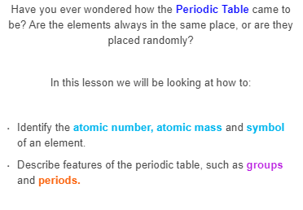

Slide 3

Atoms are neutral, which means that they have the same amount of negative electrons as positive protons.
Due to this, the atomic number of an atom also tells us how many electrons it has.

Slide 4
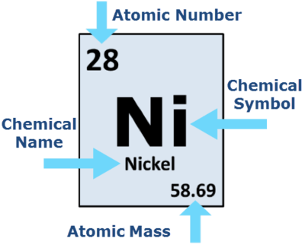
The mass number of an atom is the combined mass of the protons and neutrons in the nucleus.
Atomic mass is the average mass number of all isotopes of an element. This value is found on the periodic table.

Slide 5
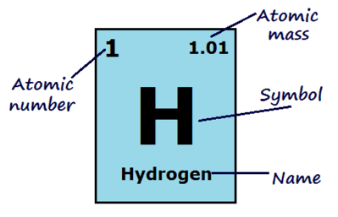
The atomic mass of an element is usually not a whole number, for example, hydrogen has an atomic mass of 1.01.
This is because elements can have different isotopes, which are atoms with the same number of protons and a different number of neutrons.
The atomic mass is the average mass of all known isotopes of an element.

Slide 6
The Periodic Table is a table that shows us all the known elements.
Each element is ordered by increasing atomic number.
As shown, it consists of eighteen vertical columns (groups) and seven horizontal rows (periods), with two extra rows below.

Slide 7
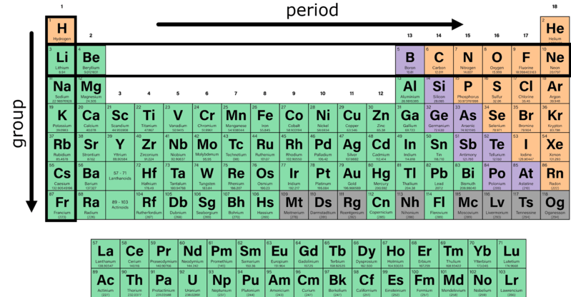

Slide 8
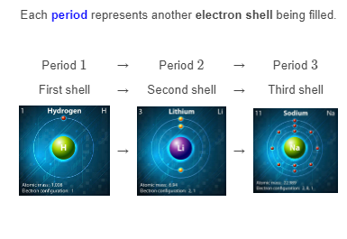

Slide 9
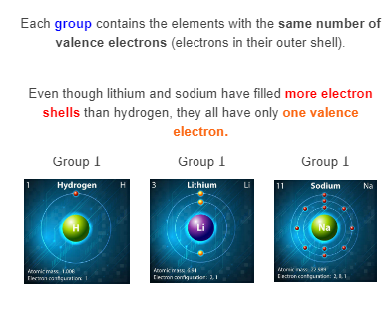

Slide 10
Elements are grouped by the number of valence electrons because these are the electrons that are involved with bonding, and therefore dictate the properties of an element.
For example, every element in group 18 has a full outer shell, and none of them react except under extreme circumstances.
The properties of each group will be explained further in the Characteristics of Elements lessons.

